Slide 1


Oracle database
Lecture 40

Slide 2

Today’s Agenda
Executing SQL From PL
Executing INSERT,UPDATE & DELETE
Executing SELECT INTO
Examples

Slide 3
Executing SQL
From the body of a PL-SQL script we are only allowed to execute DML and TCL statements i.e INSERT , UPDATE , DELETE,COMMIT, ROLLBACK are the only valid SQL commands which can be executed from a PL-SQL script.
Execution of SELECT is allowed but with the help of CURSOR.

Slide 4
Executing INSERT
WAP to accept values for BOOKID ,BOOKNAME , SUBJECT and BOOKPRICE columns and insert the record in the table ALLBOOKS.
For writing the above script we will require 4 variables declared to be of the same data type and size as the 4 columns of the table ALLBOOKS.

Slide 5
Executing INSERT
This is done use %TYPE attribute.
The %TYPE attribute allow you to declare a constant, variable, or parameter to be of the same data type as an existing database column.
Syntax:
<var_name> <table_name>.<col_name>%TYPE;
Example:
roll Student.roll_no%TYPE;

Slide 6
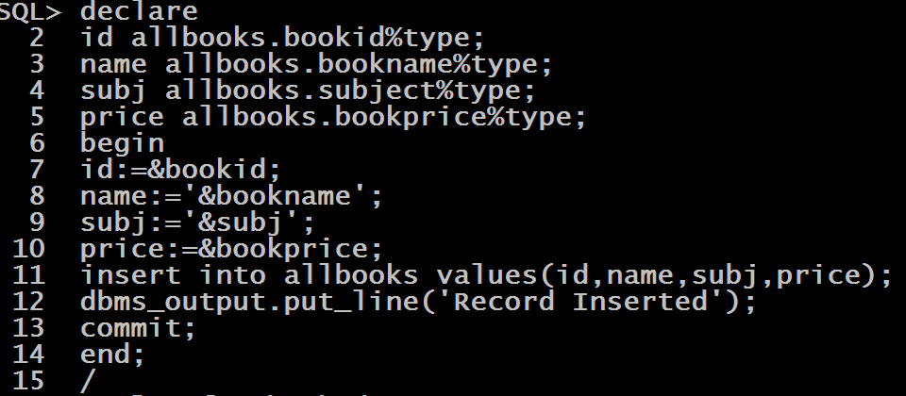
Executing INSERT

Slide 7
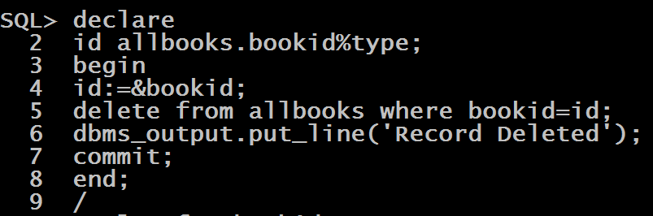
Executing DELETE
WAP to accept value for BOOKID from the user and delete the record of that book from the table ALLBOOKS

Slide 8
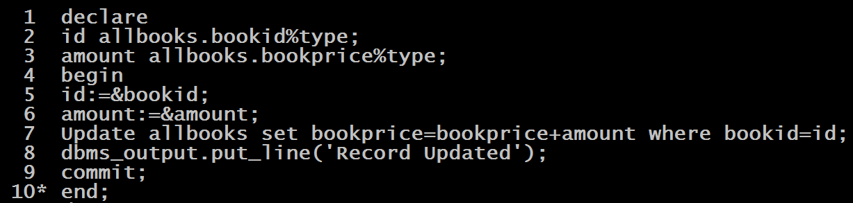
Executing UPDATE
WAP to accept value for BOOKID and AMOUNT from the user and increase the BOOKPRICE of the book with the given BOOKID by adding the given AMOUNT in the table ALLBOOKS

Slide 9
PL-SQL Select Into
PL/SQL SELECT INTO statement is the simplest and fastest way to fetch a single row from a table into variables.
The following illustrates the syntax of the PL/SQL SELECT INTO statement:
SELECT column_list
INTO variable_list
FROM table_name
WHERE condition;

Slide 10
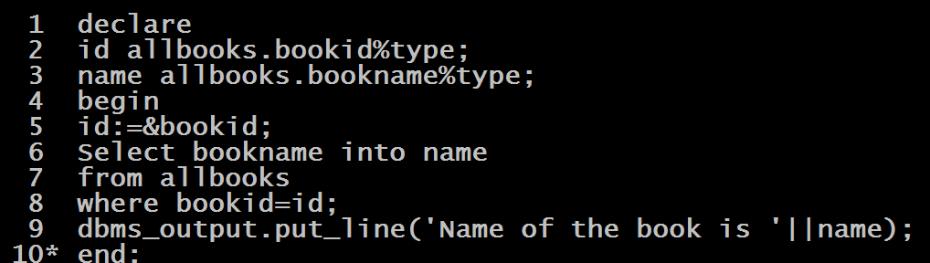
Program
WAP to accept a bookid from the user and display the name of the book from the table ALLBOOKS

Slide 11
Selecting Complete Row
WAP to accept a bookid from the user and display the complete record of the book from the table ALLBOOKS

Slide 12
Select Into Common Errors
If the number of columns and expression in the SELECT clause is greater than the number of variables in the INTO clause, Oracle issues this error:
ORA-00947: not enough values
Oracle issues the following error if the number of columns and expression in the SELECT clause is less than the number of variables in the INTO clause:
ORA-00913: too many values

